Slide 1
EE P 596 Presentation: Album decade Classification
Team: Chun-Wei(William) Liao

Slide 2
Problem Statement
We propose a method to classify the album's release decade (1950s–2020s) based on its cover image. The core goal is to verify the existence of visual patterns within the same decade. Through this project, we will test the hypothesis that the pattern uniformity within a single decade is a machine-learnable signal, rather than a subjective human illusion.

Slide 3
Problem Summary
Implement two methods to analyze album covers in our self-collected dataset:
Collect the dataset via a scraper script and the iTunes API.
Attempt 1: A Classification task.
Attempt 2: A Regression task.

Slide 4

Proposed method - Classification
Use DINOv2 to generate embeddings. Train a Fully-Connected (FC) Layer to classify the album's decade.
768 dimensional
512
8
…1950
FC
FC
DinoV2
…1960
Relu
Softmax
…1970
…1980
…1990
…2000
…2010
…2020

Slide 5
Proposed method - Regression
Use DINOv2 to generate embeddings. Train a Fully-Connected (FC) Layer to predict the album’s year.
768 dimensional
512
1
FC
FC
DinoV2
Relu
Year = ?

Slide 6
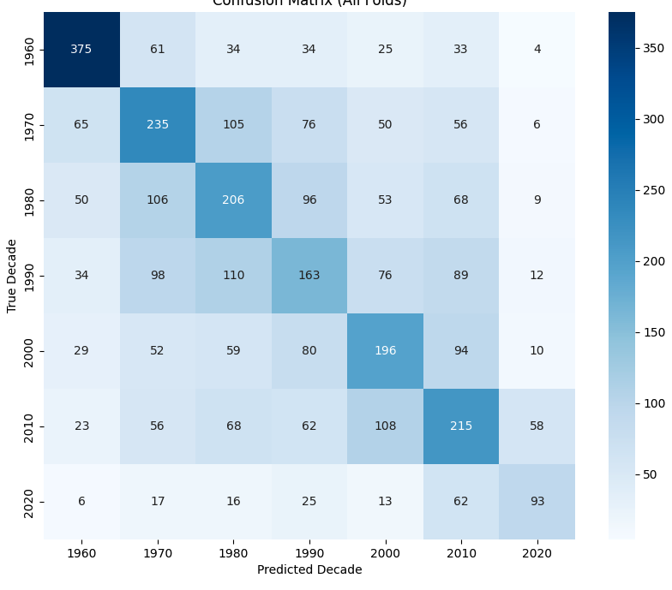
Result - Classification
Top-1 Accuracy: 0.4072
Off-by-one Accuracy: 0.6753

Slide 7
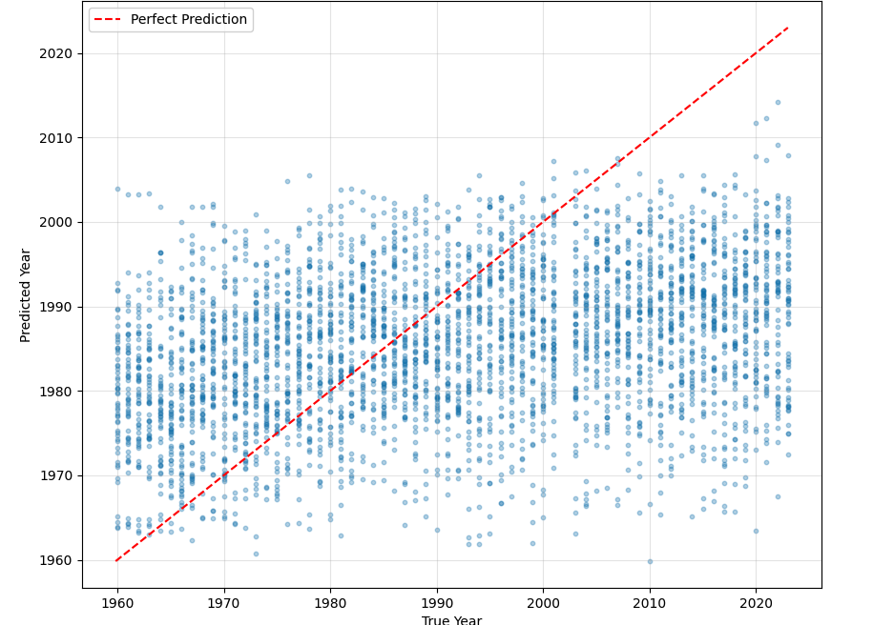
Result - Regression
The model tends to predict years centered around 1985.

Slide 8
Conclusion
We propose a method to classify the album's decade and another method to predict its release year.
We collect our data using the iTunes API.
We use DINOv2 to create embeddings and an FC layer for classification and prediction.
We prove that a visual pattern exists in albums from the same decade.
Future work
Collect non-English album for training
Track the visual patterns of albums based on their release region, proving that shared patterns exist not only across time (decade) but also space (geographical location)

Slide 9










1970
2010

Slide 10



